Slide 1



Crops Recommendation System
Submitted by:
Roaa Albahrani (ID: 219022805)
Batool Alsowaiq (ID: 219015035)
Noura almosinad (ID: 219010636)
Supervised by:
Ms. Nura A. Aljaafari

Slide 2
Introduction
Machine learning (ML): is a subset of artificial intelligence that builds an automated model that can learn from a data sample, make decisions, and recognize patterns from computational learning theory without being programmed to achieve a desired outcome.
ML has several types of machine learning algorithms:
Supervised learning: the system has training set of data with result vectors.
Unsupervised learning: used for data with no historical labels therefore the algorithm must discover what is being shown since the system does not have the correct answer.
Reinforcement learning: the algorithm learns via trial and error which gives the best rewards.
Our project is mainly focused on Supervised learning.

Slide 3

Problem statemet
Most farmers face the problem of plant death or delayed growth, which causes the lack of afforestation and waste of agricultural crops. In our project, we find the solution for that problems.

Slide 4
Acquire the dataset
We required a dataset as a machine learning model completely works on data.
The dataset contains:
8 columns
2200 record
17600 fields
N (Nitrogen) | P(Phosphorous ) | K (Potassium ) | temperature | humidity | PH | rainfall | Label
int64 | int64 | int64 | float64 | float64 | float64 | float64 | STRING

Slide 5

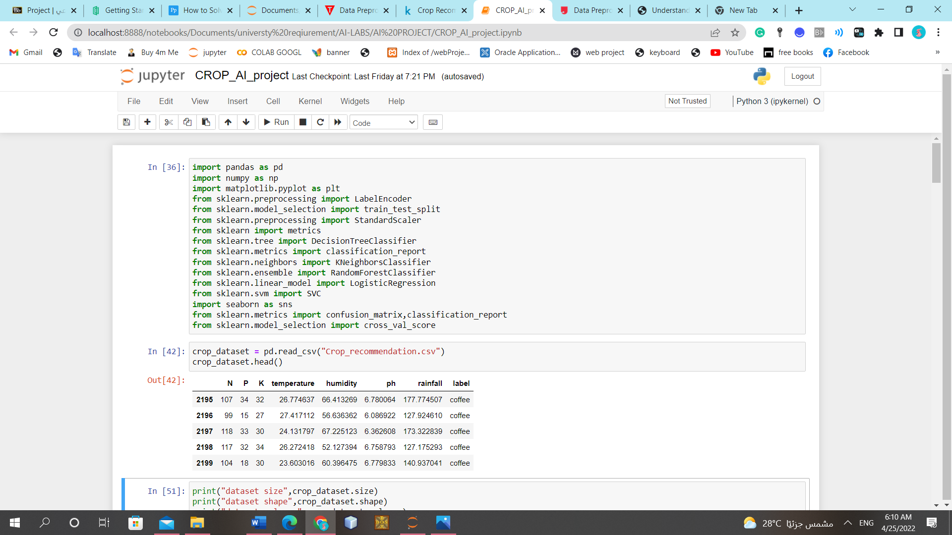
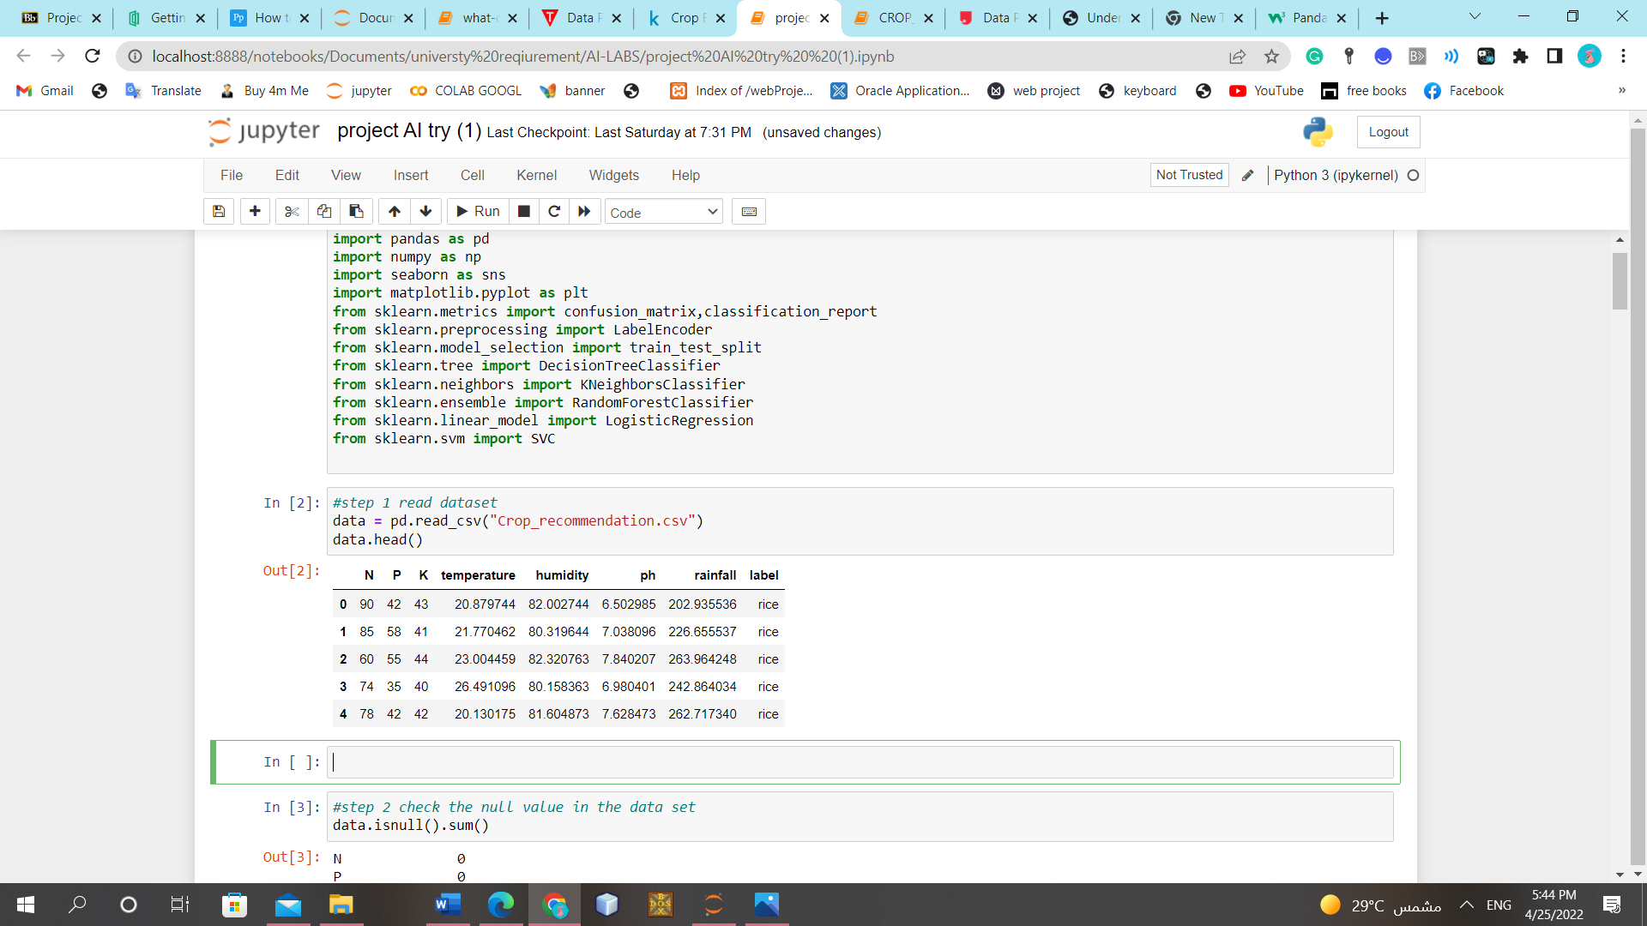
data processing
Import all the crucial libraries
Read the Datasets

Slide 6
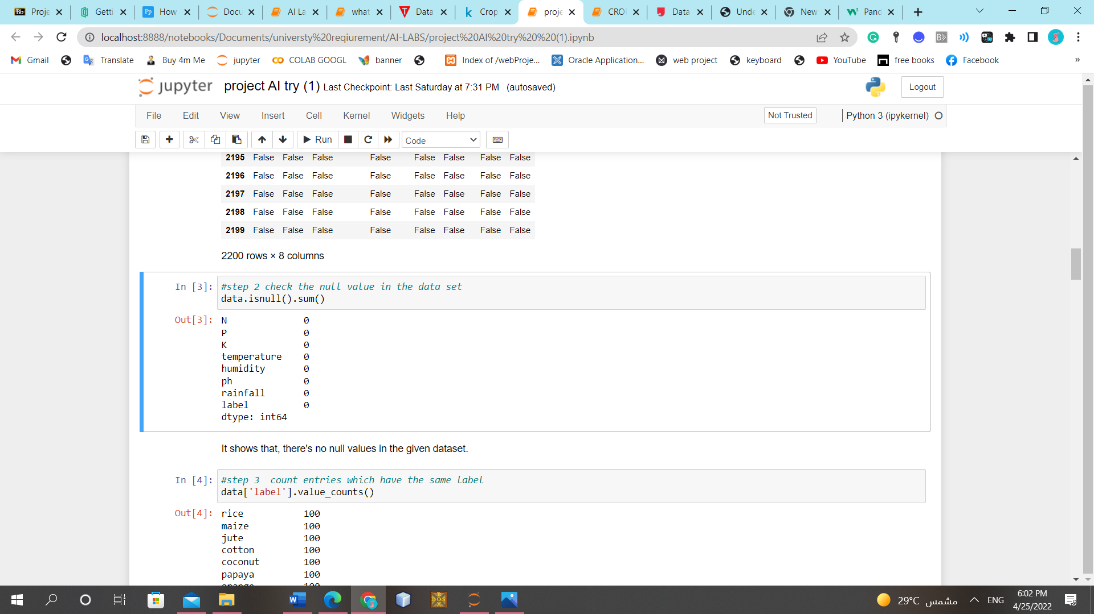
Data processing
Handling Missing data

Slide 7
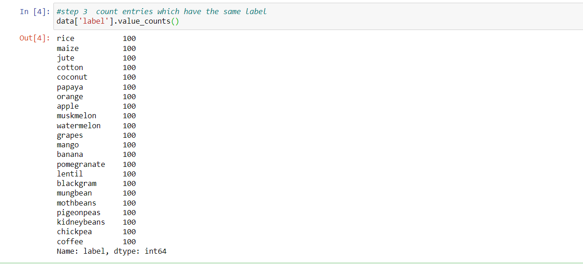
Data processing
Checking the balance of dataset

Slide 8
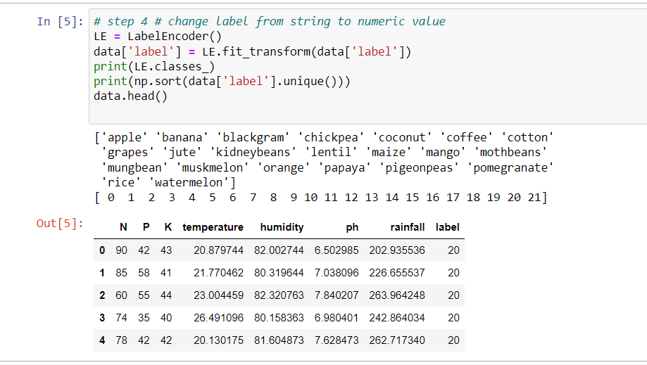
Data processing
Encoding Categorical data

Slide 9
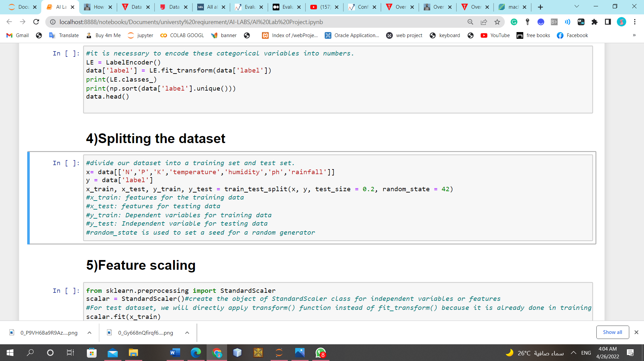
Data processing
Splitting the dataset

Slide 10
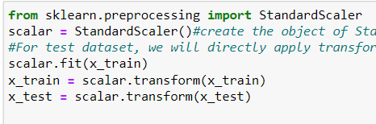
Data processing
Feature scaling
It is a technique to standardize the independent variables of the dataset in a specific range

Slide 11

How to select ML model
Model selection is the process of choosing a suitable machine learning model from several models for a training dataset. The process could be applied on various types of models or even on same type of models and it is useful for solving complex problems using very large data with high accuracy and minimum costs.
To select the best model, we must determine the type of machine learning algorithm that we will working on it which will be supervised machine learning for our dataset. Supervised learning is beneficial in two areas: classification and regression problems.

Slide 12
How to select ML model.. continued
we should follow these guidelines for selecting suitable machine learning models:
collect data.
check for anomalies.
missing data and clean the data.
perform statistical analysis and initial visualization.
build models, check the accuracy, and present the results.
we examined our problem with four different models which they are :
Random Forest.
Support Vector Machines.
K-nearest neighbors.
Decision Trees.
After we applied all these models, we have obtained the best model depending on the high accuracy which was achieved by Random Forest model.

Slide 13
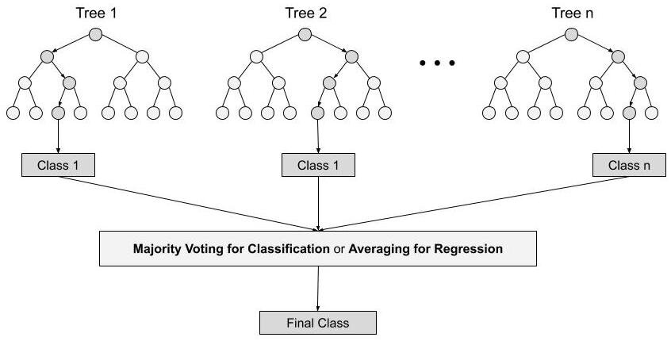
Random forest algorithm
Notes:
Random forest algorithm steps:
1. In Random Forest n number of random records are taken from the data set having k number of records.
2. Individual decision trees are constructed for each sample.
3. Each decision tree will generate an output.
4. Final output is considered based on Majority Voting or Averaging for Classification and regression respectively.

Slide 14
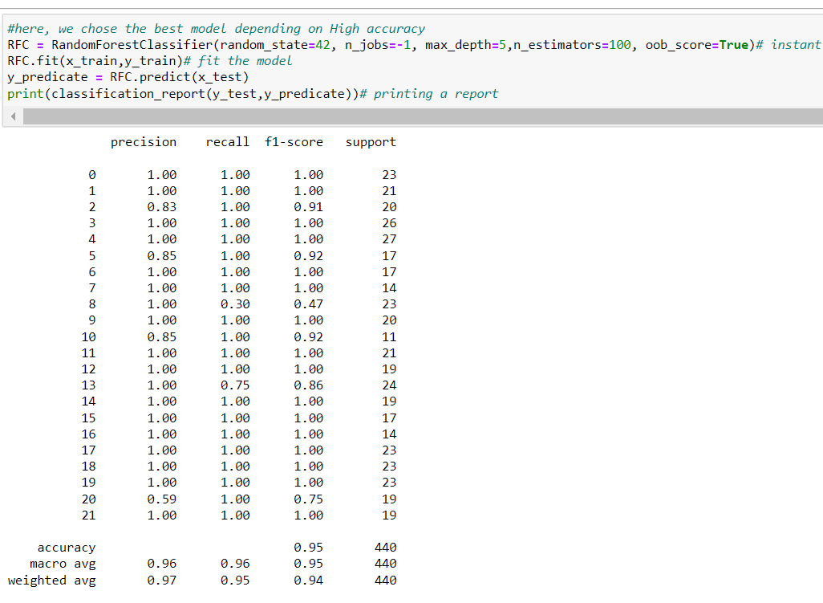
implementation of Random forest algorithm

Slide 15
Evaluation Metrics
After training the machine learning model using train set of data, it is important to use evaluation metrics in order to know how well is the performance of ML model. There are different evaluation metrics for a different set of machine learning algorithms. Classification metrics used for evaluating classification models and regression metrics used evaluating regression models.

Slide 16
Evaluation Metrics
- Classification Evaluation Metrics (continued) :
Different approaches for this type of evaluation metrics:
1 - Confusion matrix 2- Accuracy. 3- Precision. 4- Recall. 5- Specificity. 6- F1 Score, etc.

Slide 17
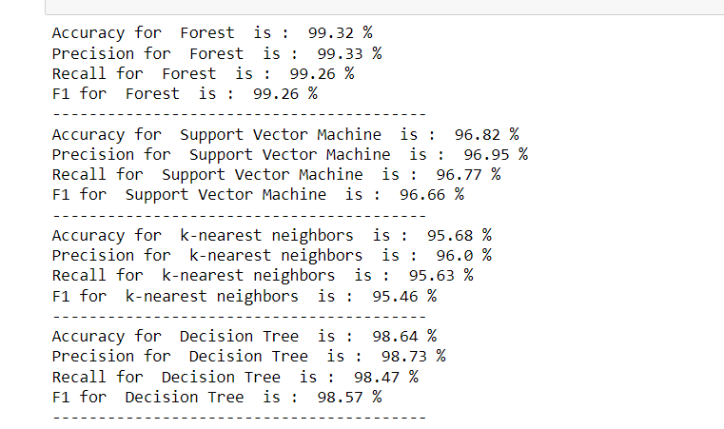

Our dataset is balanced, so the best approach to evaluate the ML model Accuracy, but we will test the rest of evaluation Metrex for more efficiency. We use it to compare between the different ML models in order to select the best of them that fit more with our dataset.

Slide 18
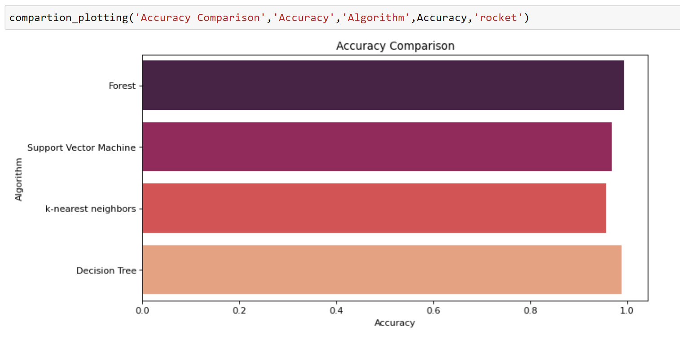
Compassion Plotting Function

Slide 19
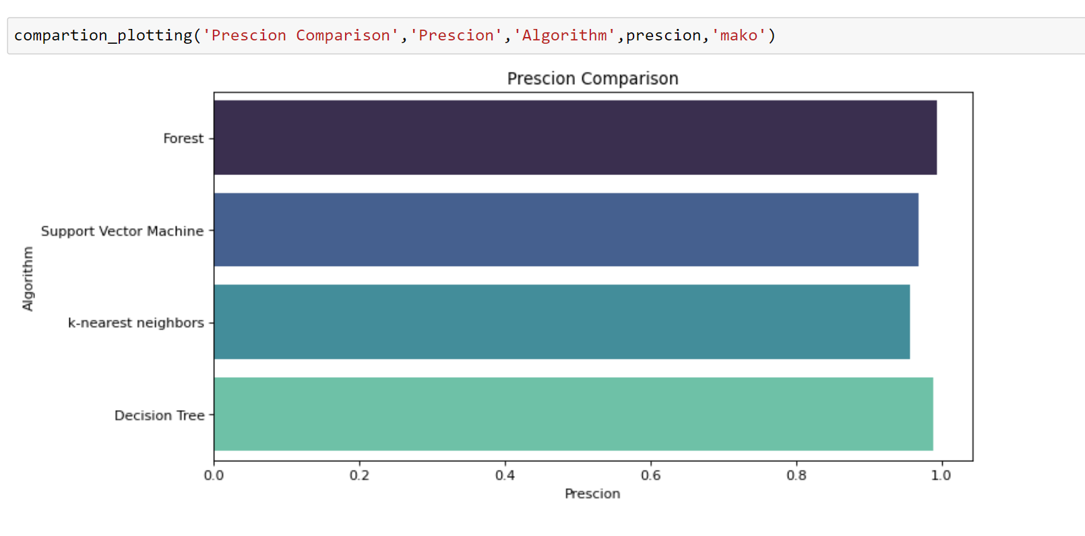
Compassion Plotting Function.. continued

Slide 20
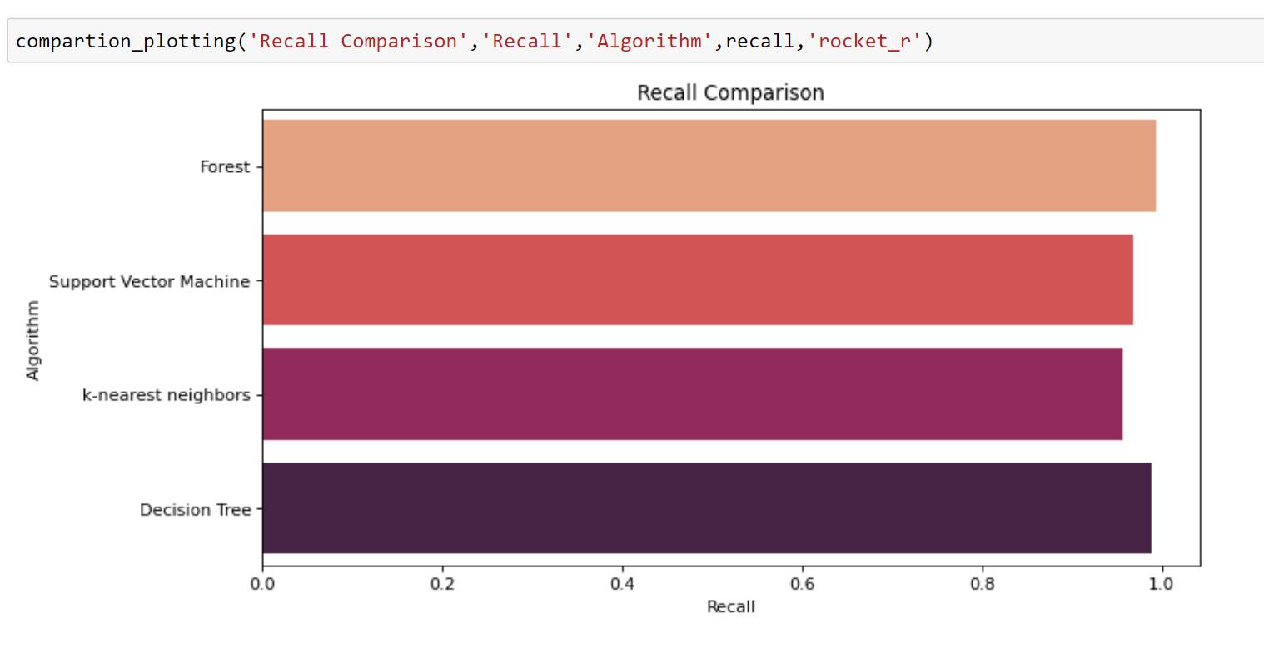
Compassion Plotting Function.. continued

Slide 21
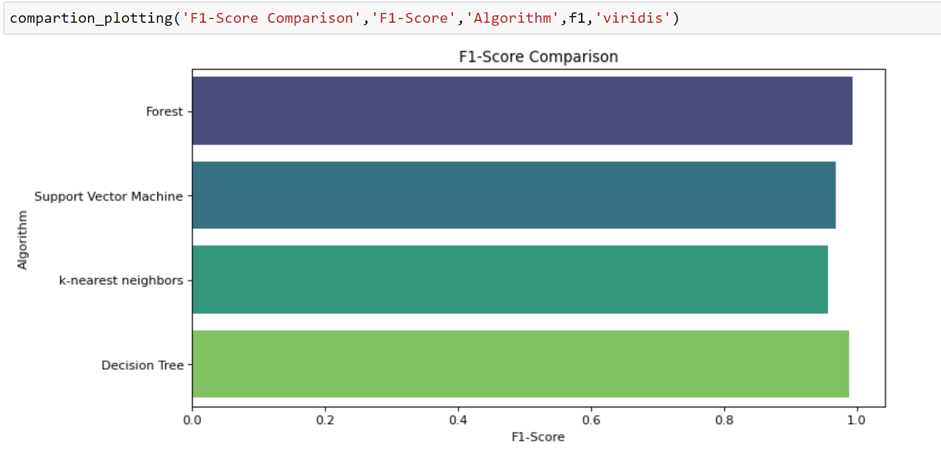
Compassion Plotting Function.. continued

Slide 22
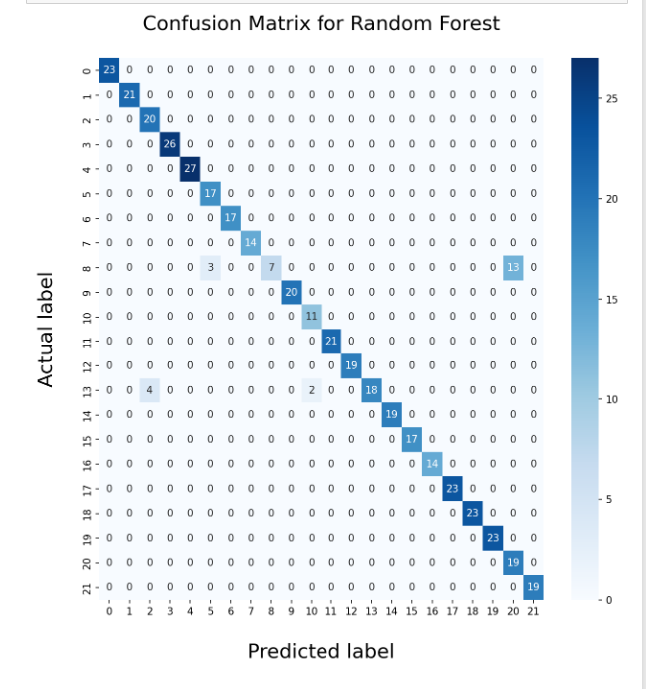
Confusion Matrix for random forest

Slide 23
Checking overfitting and underfitting
In machine learning overfitting and underfitting are consider as major problem that face the ML model and deteriorate its performance. Hence, the aim of each machine learning model is to reach generalization.

Slide 24
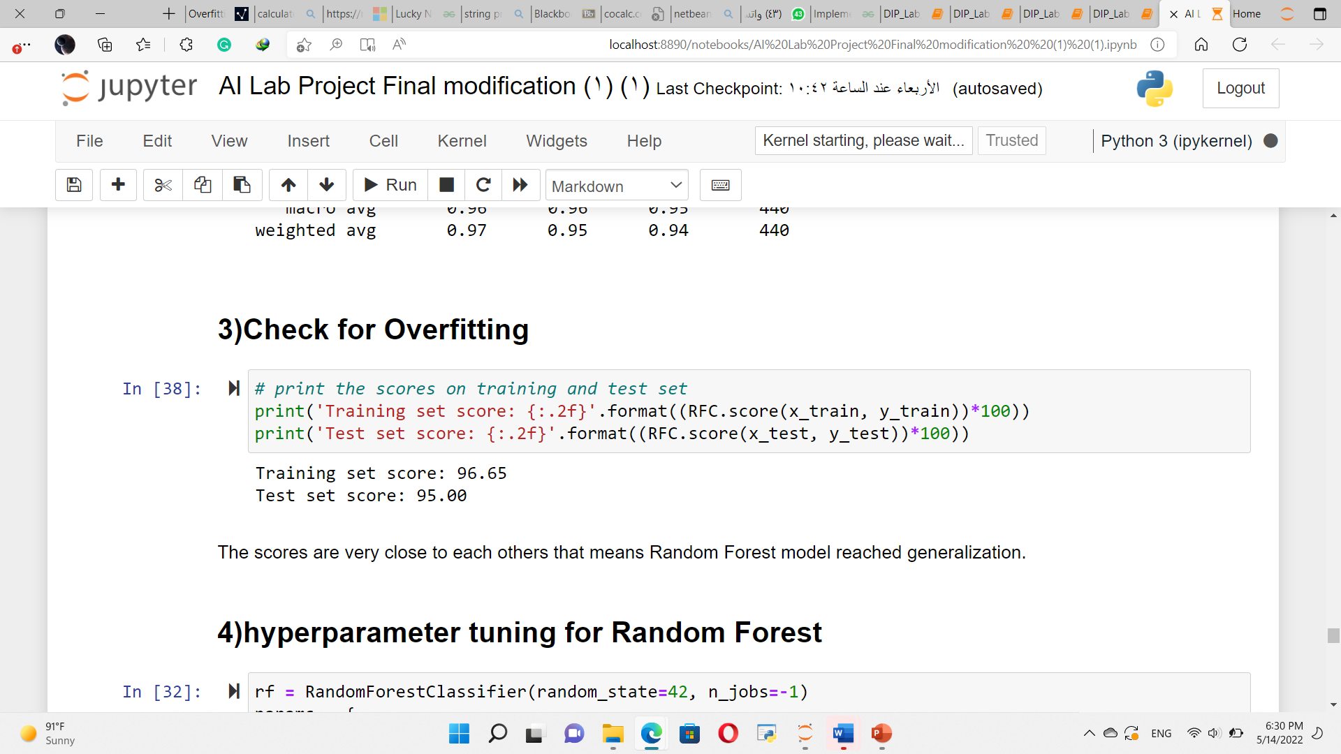
Our dataset we checked if these problems exist with our model by displaying the evaluating of model with training dataset and testing dataset.

Slide 25
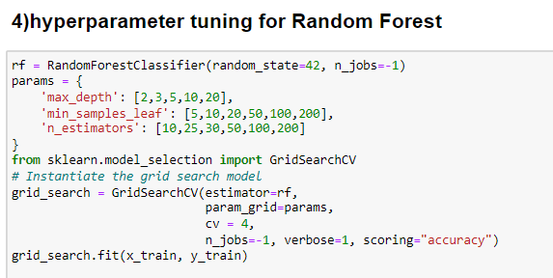
Hyperparameters
Hyperparameters are used in random forests to enhance the performance and predictive power of models or to make the model faster.
Output:
max_depth=20
min_samples_leaf=5
n_jobs=-1
random_state=42
Notes:
The grid consists of selected hyperparameter names and values
Will run and compare 180 values
GridSearchCV class has the option to perform cross validation to resample the training and test data into multiple folds.
If we decide to use cross validation (let’s say with 5 folds) this means grid search will have to evaluate 1200 (=240*5) model performances.
n_estimators: Number of decision trees max_features: Maximum number of features considered while splitting max_depth: Max depth of the tree min_samples_leaf: Minimum number of data points in a leaf node bootstrap: Sampling with or without replacement
n_jobs: Number of jobs to run in parallel random_state: Seed verbose: Printing information while training continues oob_score: Whether or not to use out-of-bag samples

Slide 26
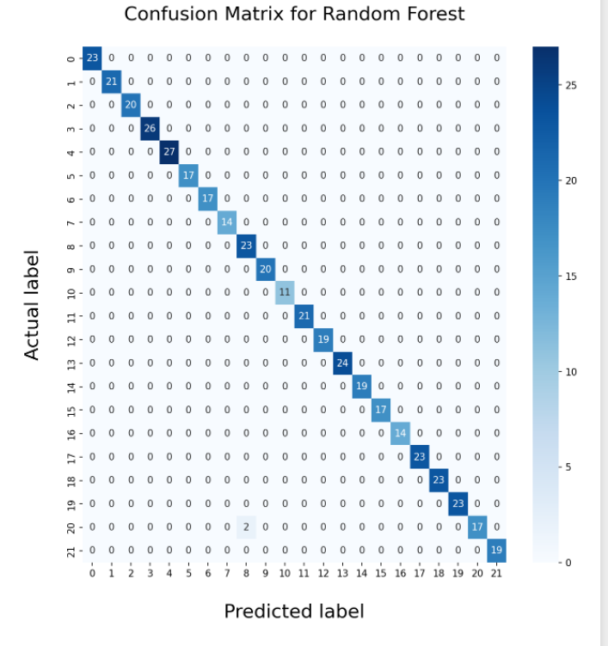
Confusion Matrix for random forest

Slide 27

Conclusion
Each algorithm gives different values of recall , precision , and accuracy. The highest accuracy is given by Random Forest algorithm. it is one of the best techniques with high performance.

Slide 28
tasks
Name | Task
Noura almosinad | Data preprocessing +hyperparameter
Batool | Check overfitting +underfitting +evaluation matrix
Roaa | Introduction + select the best machine learning model

Slide 29

Thank you!

